Slide 1
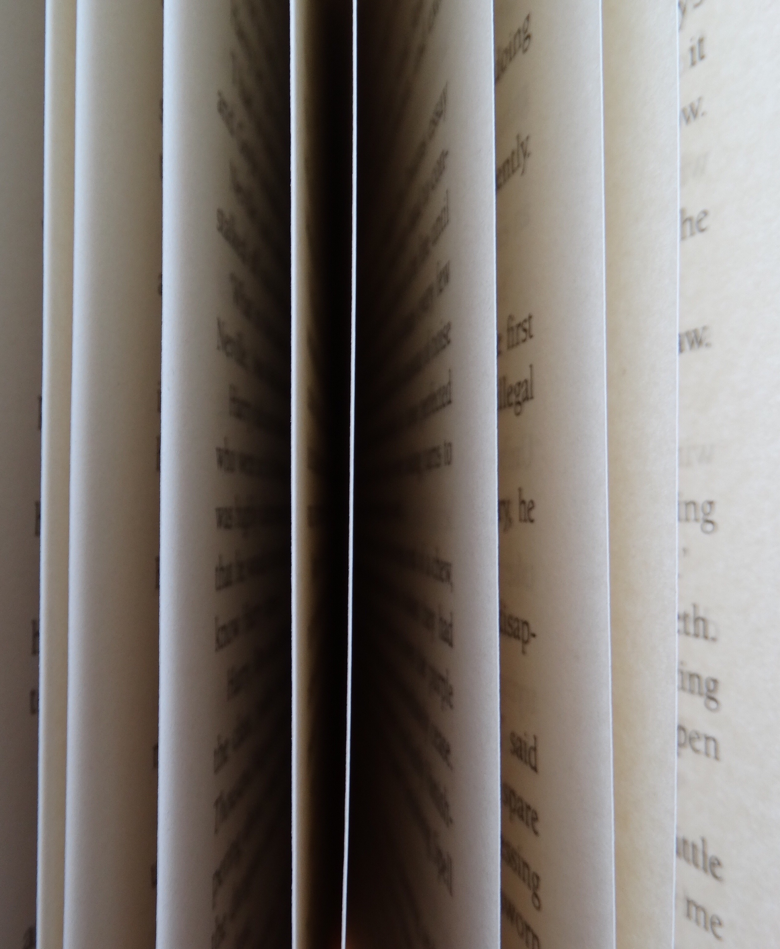
Virtual Board
by Shirin Koul 19001011055
Yash Magoo 19001011069

Slide 2
Introduction
Virtual Board is a hands free digital drawing project.
This project equips the user the ability to draw in air without the use of any advanced tools like styler.
This project requires only a camera as a external hardware which is already present in nearly all laptops today.
This project detects hands and based on gestures it draws or erases on the canvas.

Slide 3
Tools required
Python
Pycharm
Open CV
Numpy
Mediapipe

Slide 4
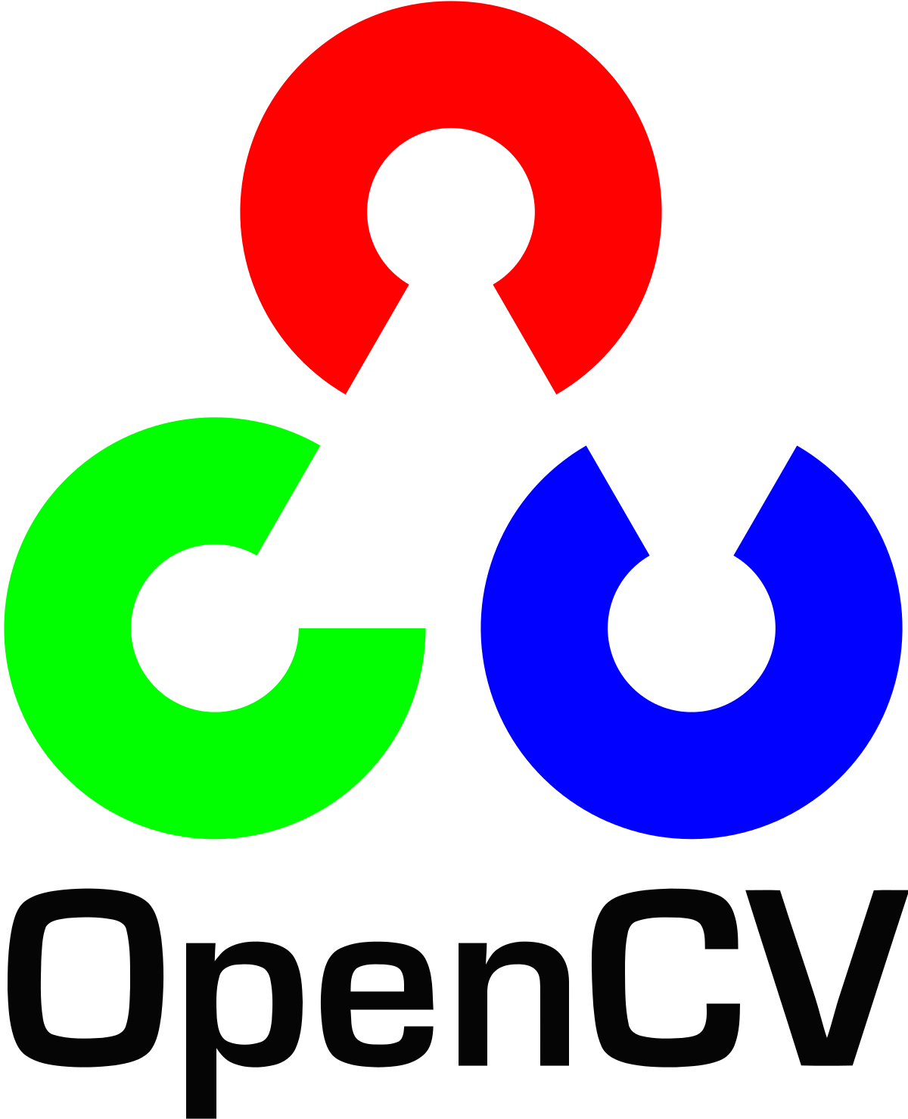
Open CV
This library helps
us detect
the objects
in our camera.

Slide 5
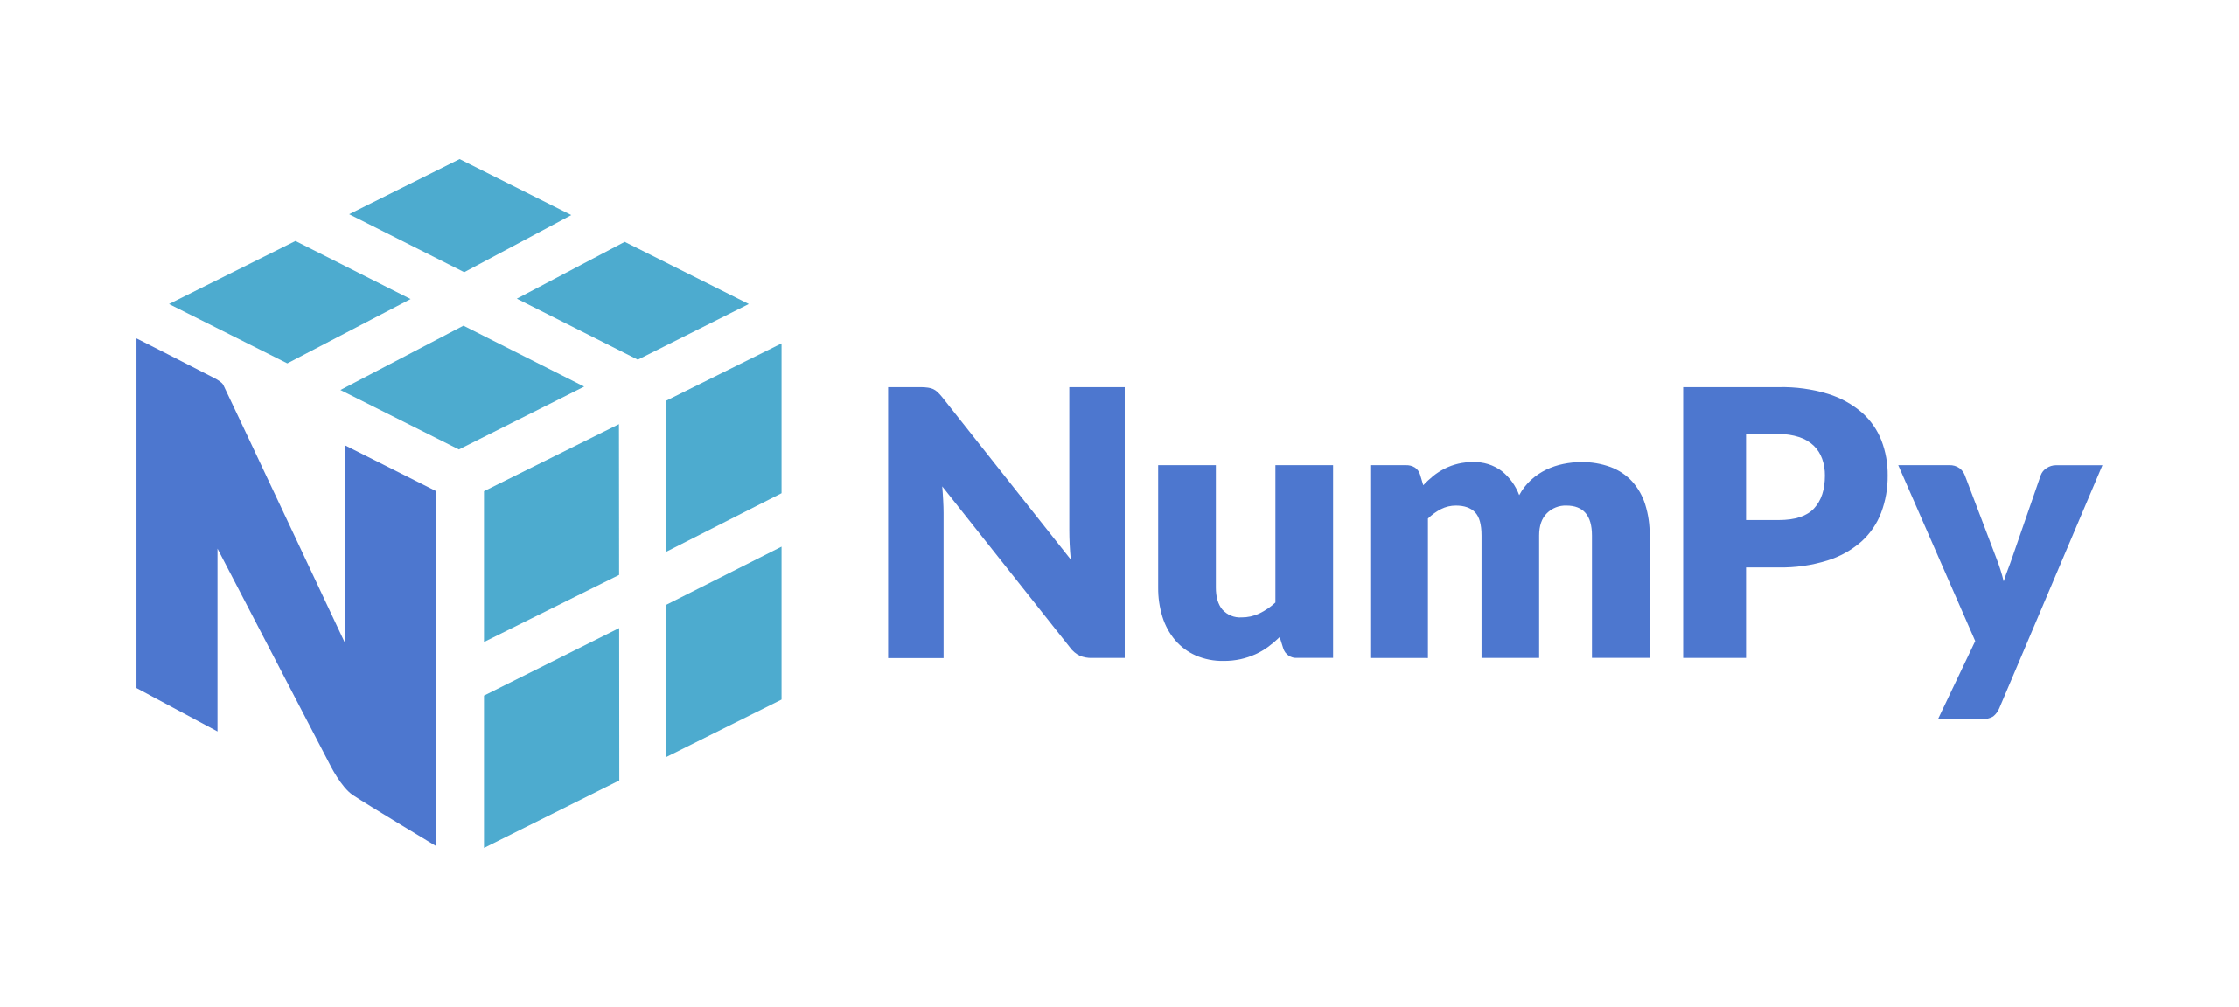
Numpy
Numpy stands for Numerical Python, this library helps us build multidimensional array.
In this project, we used to it build our canvas on which all out basic drawings was implemented.

Slide 6
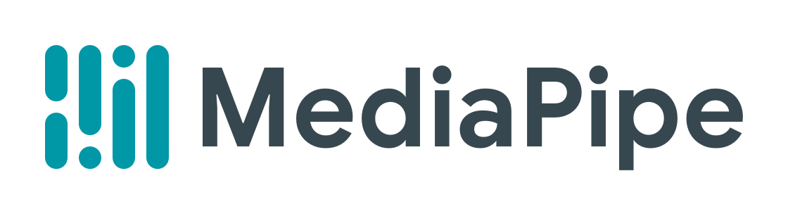
MediaPipe
Mediapipe is a google based open source library.
Mediapipe takes the input image and infers 21 3D landmarks on the hand.

Slide 7
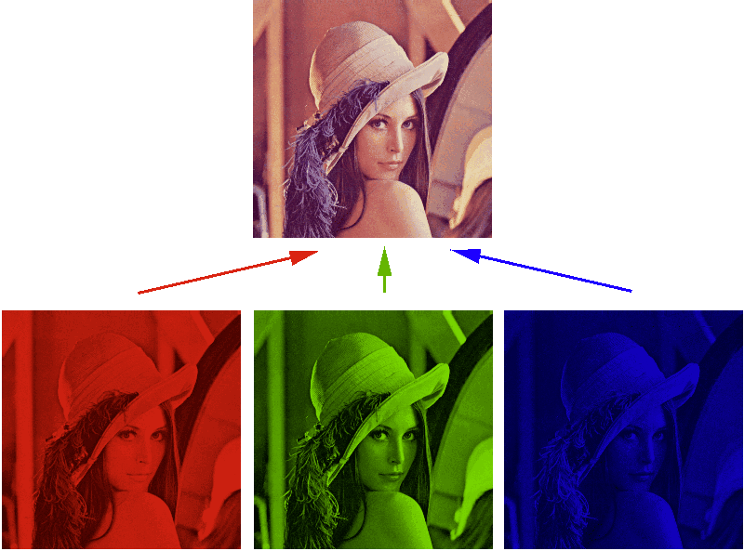
RGB image
Coloured images consists 3 different colors.
So every pixel is stored as RGB combination using the Numpy library.

Slide 8
Intention
To help teachers while online classes in the era of covid.
It help people not well versed with the technology.

Slide 9
Functionality
There are various modes based on gestures like:
Drawing mode
Eraser mode
All clear canvas
Colour change
No detection

Slide 10
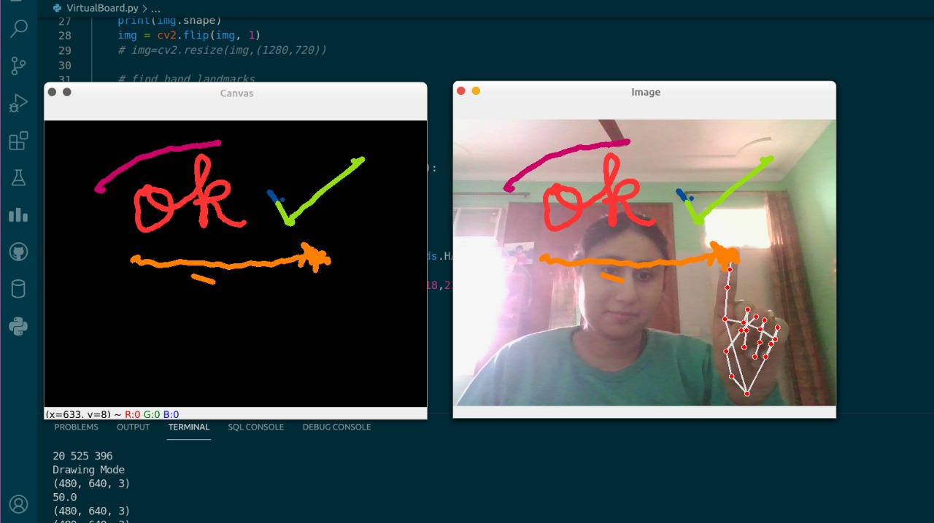
Drawing mode

Slide 11
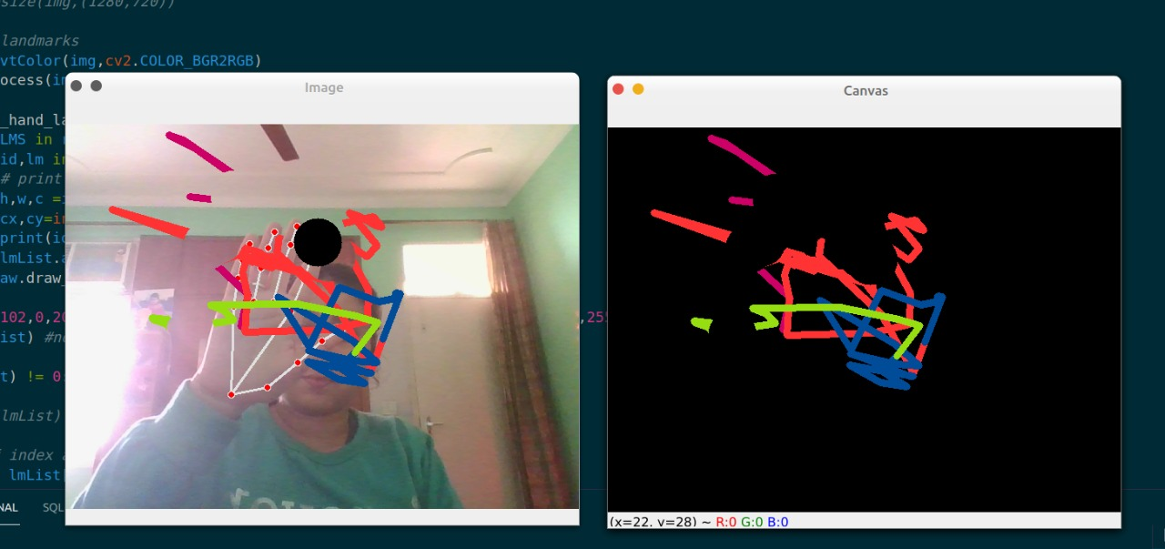
Eraser mode

Slide 12
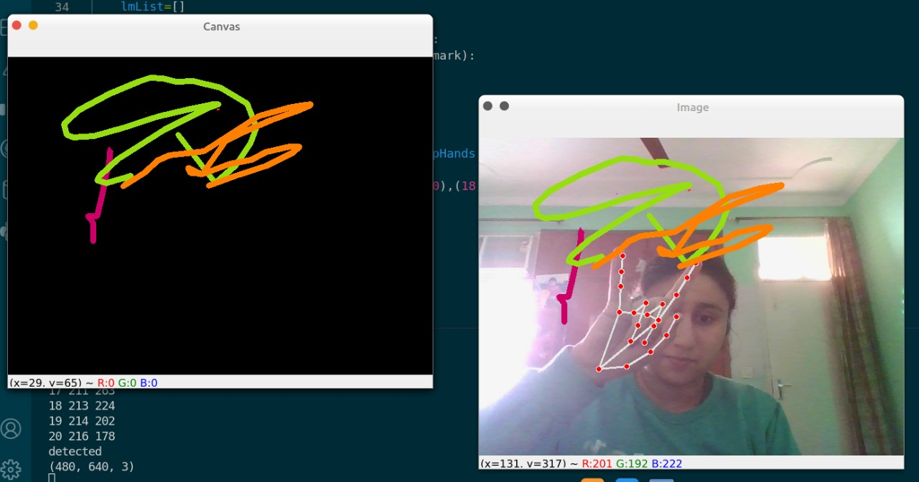
Change colour

Slide 13
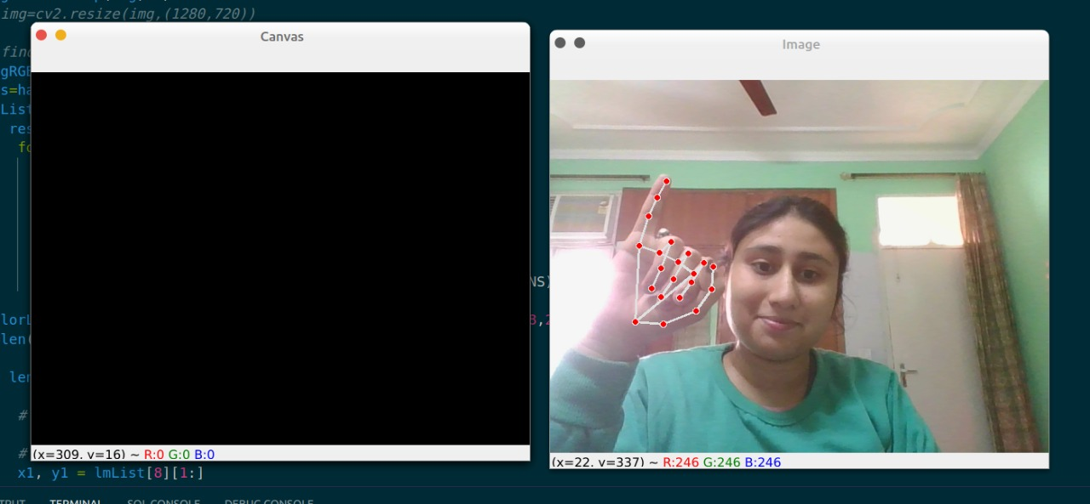
All clear mode

Slide 14
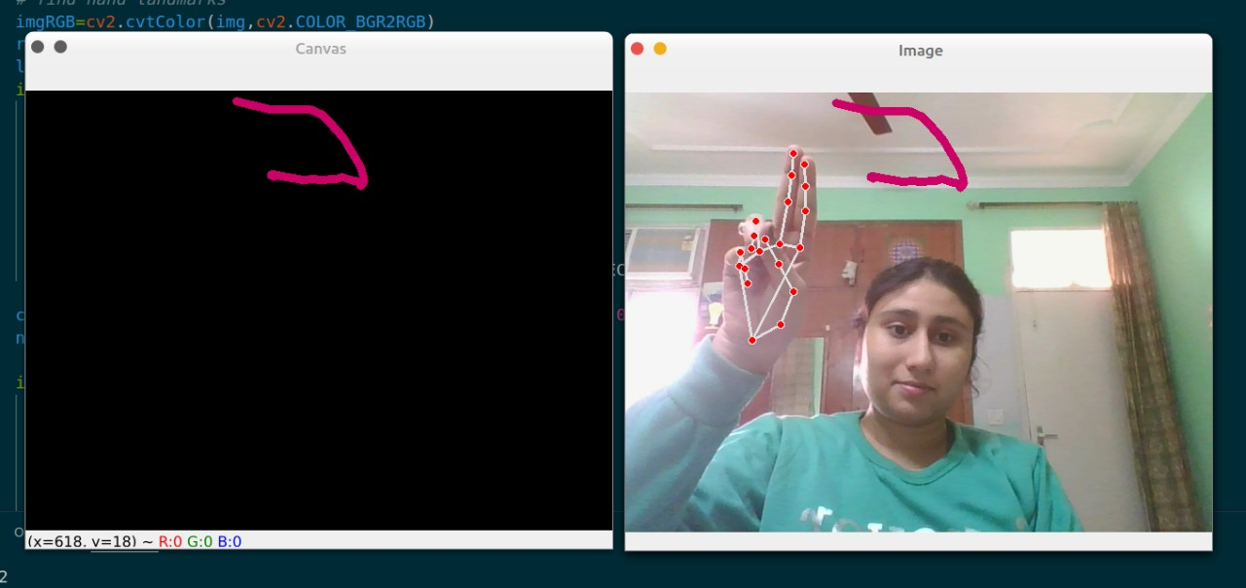
No detection

Slide 15
Now coming to our
project implementation

